Slide 1
Analysis - Flight delays in USA
Team members:
Hari Prasad Kotapalli
Soujanya Navuluru
Sabarnath Chowdary Maddinieni
Tej Gottapu

Slide 2
Flow of content
Introduction/Context
Objective
Data Overview / Exploratory Data Analysis
Citation
Data Preprocessing
Models (Regression & Prediction)
Challenges
Future Scope
Conclusion

Slide 3


US Federal Aviation Administration (FAA): Federal Aviation Administration (FAA) is a governmental body of the United States with powers to regulate all aspects of civil aviation, under the ministry “Department of Transportation” - Aircraft Registration & Safety, Construction & Operation of airports, Air traffic management, Certification of pilots/personnel, Runway Safety, Environmental issues - As per National Plan of Integrated Airport Systems (NPIAS), there are about 5,170 airports in the United States open for public, of which “503 airports serve Commercial flights.”
INTRODUCTION:

Slide 4
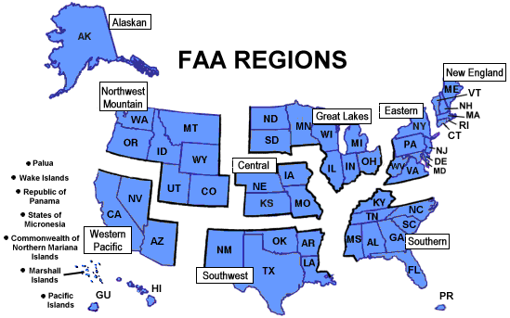
US Aviation Regional Guidance by Geography:
Introduction:
Alaskan (AK)
Central (IA, KS, MO, NE)
Eastern (DC, DE, MD, NJ, NY, PA, VA, WV)
Great Lakes (IL, IN, MI, MN, ND, OH, SD, WI)
New England (CT, ME, MA, NH, RI, VT)
Northwest Mountain (CO, ID, MT, OR, UT, WA, WY)
Southern (AL, FL, GA, KY, MS, NC, PR, SC, TN, VI)
Southwest (AR, LA, NM, OK, TX)
Western-Pacific (AZ, CA, HI, NV, GU, AS, MH)
Flight tracking by the numbers: In 2019, we tracked 68,948,849 total flights, a new record. Averaging 188,901 flights per day, that is a 10% increase over 2018. Our busiest single day was ‘25 July’ when we tracked 230,409 flights.

Slide 5
Analysis – Flight Delays in USA - To conduct a detailed analysis of the dataset on year long flight information as tracked in year 2015, within USA - To showcase key observations using the chosen dataset, through varied Data Visualization techniques - Exercise Classification models with Train dataset & apply to the test data - Make a Prediction of the Flight status as delayed or as originally scheduled - To arrive at the best fit Prediction model, with this Project - Ascertain Future scope of this project
objective:

Slide 6
DATA
Future Engineering
Exploratory Data Analysis
Conversion from Categorical to Numerical
Predicted status of Flight

Slide 7














Exploratory data analysis: - Dataset consists of variables such as int, float, string/objects - Data also describes Delays of flights - Departures & Arrivals - Information pertaining to flight Cancellation is also captured - Project includes 14 Domestic Airlines operated within USA - Flight Origin & Destination information - Frequency of flight schedules against the actuals - Flight schedules by month to year - Data by day of the week - Identified the busiest Airport as Atlanta (ATL) airport
Eda:

Slide 8
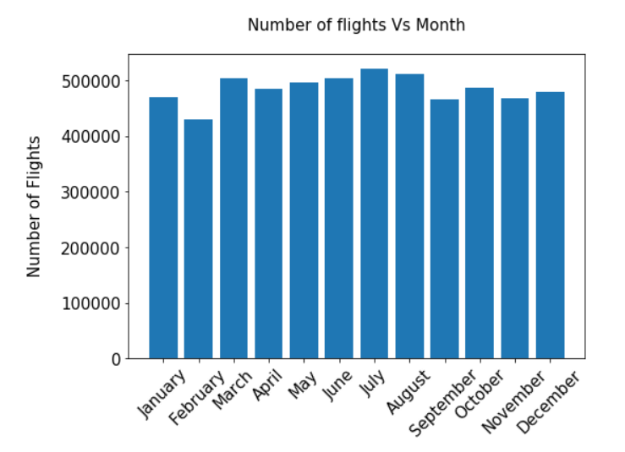
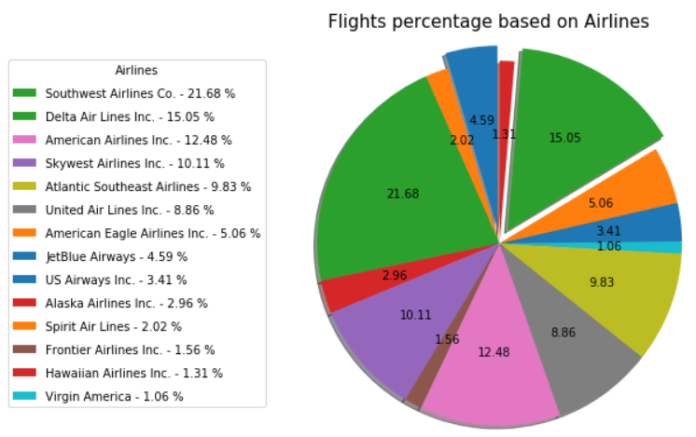
Demographics of Flights by month:
Eda (continued):
Flight schedules by Airlines

Slide 9
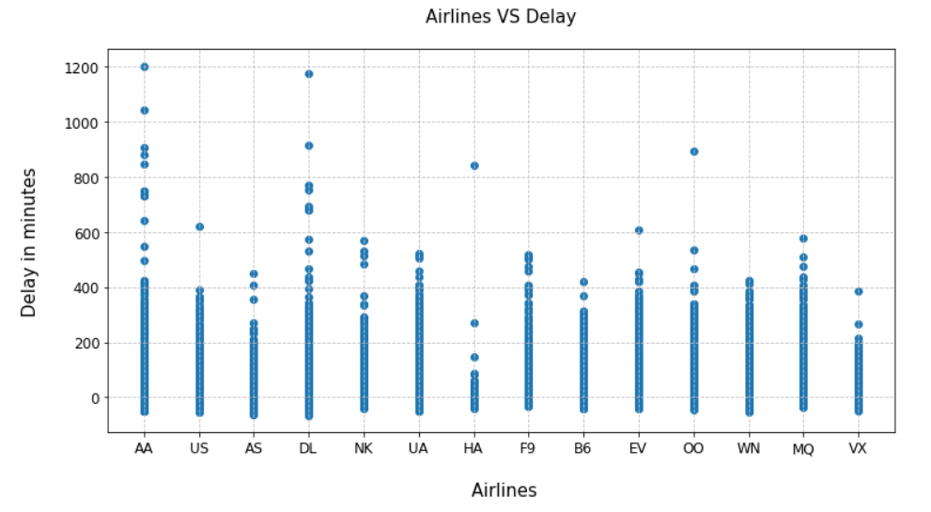
Arrivals Vs Flight delays by Airline Inc:
Eda (continued):

Slide 10
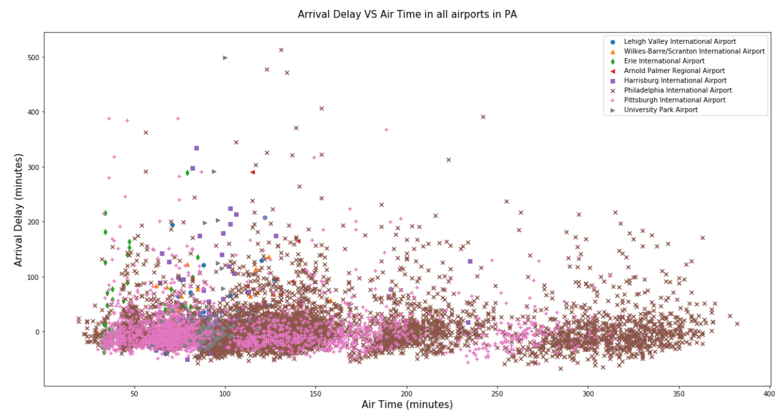
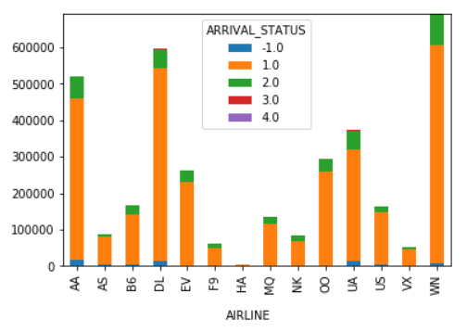
Identified Delay in Arrival of flights Vs Airtime
Eda (continued):
Arrival status by Airlines

Slide 11
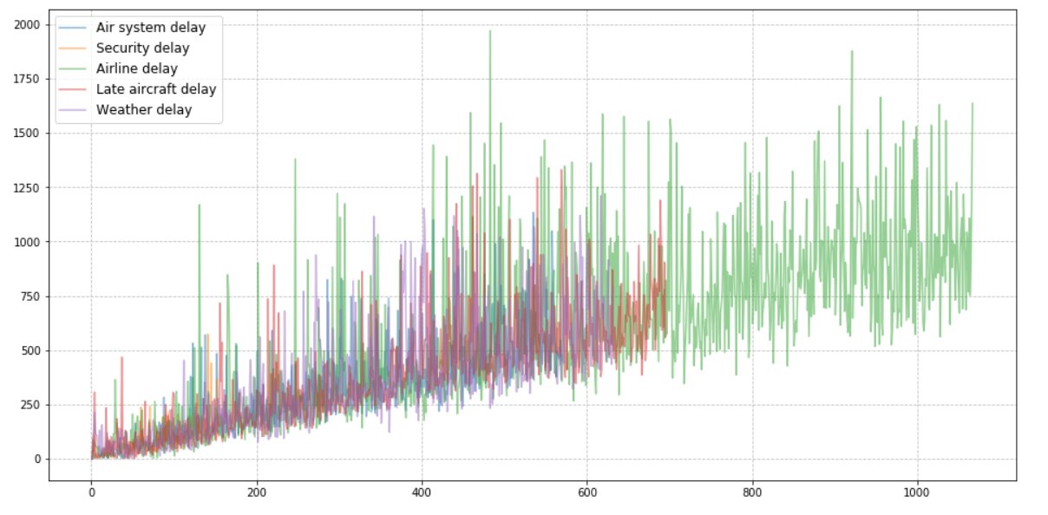
Overall Flight delays in 2015, inclusive of all types of delays:
Eda (continued):

Slide 12
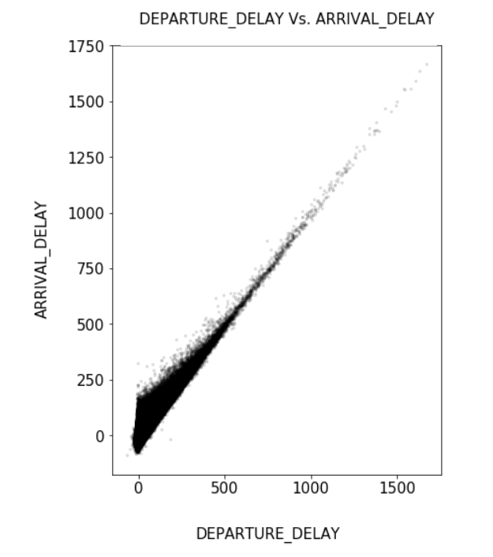
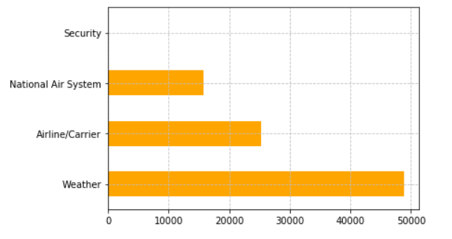
Arrivals Vs Departures:
Eda (continued):
Flight schedules Cancelled & its reasons:
Representation of count of flight Cancellations by reasons

Slide 13
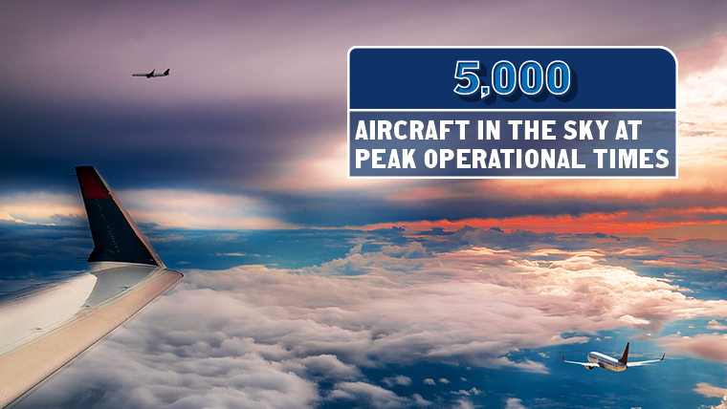

Slide 14
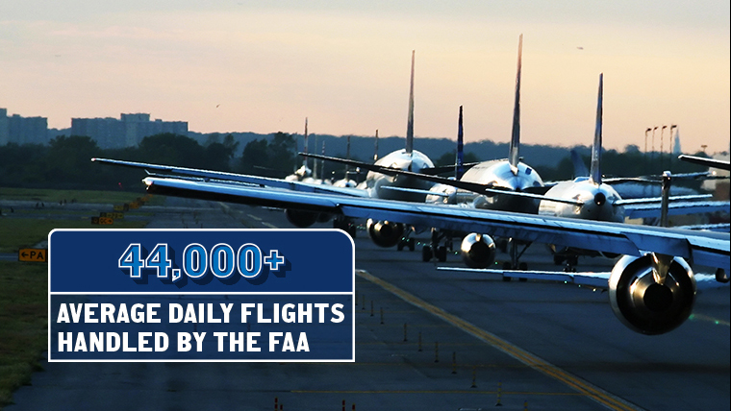

Slide 15
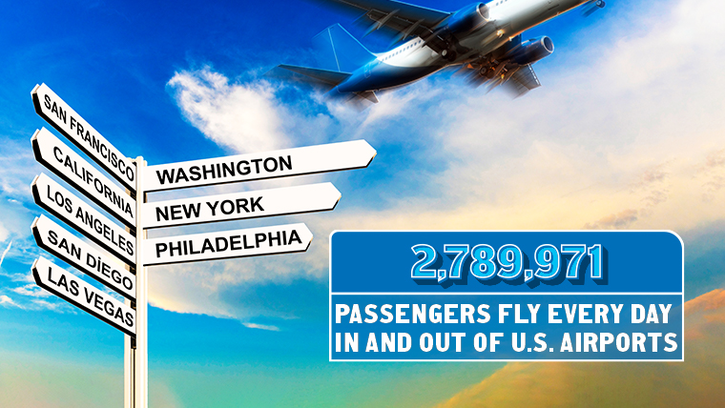

Slide 16
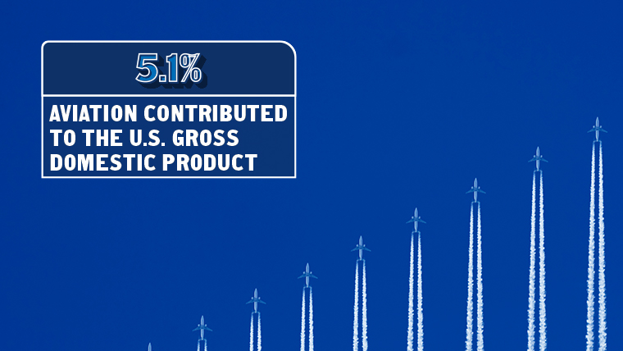

Slide 17

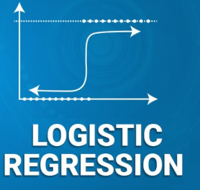
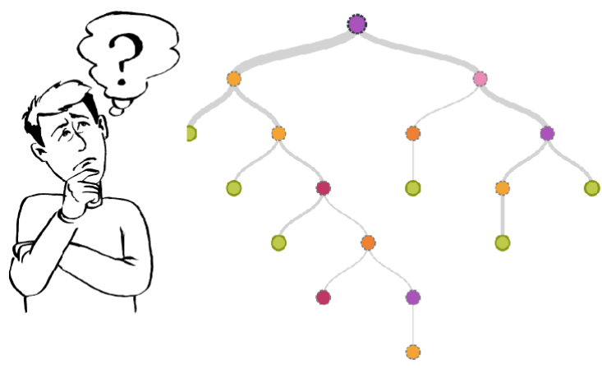
- Gaussian Naïve Bayes - Decision Tree - Logistic Regression Precision (P): 𝑃(a prediction is correct ∣ the prediction was positive) = 𝑇𝑃 / (𝑇𝑃+𝐹𝑃) Recall (R): 𝑃(a prediction is correct ∣ a label is positive) = 𝑇𝑃 / (𝑇𝑃+𝐹𝑁) F1 score: Accepted way to average the two for an overall model evaluation which is also the Harmonic mean of Precision and recall: 𝐹1 = 2𝑃𝑅 / 𝑃+𝑅
Models:

Slide 18
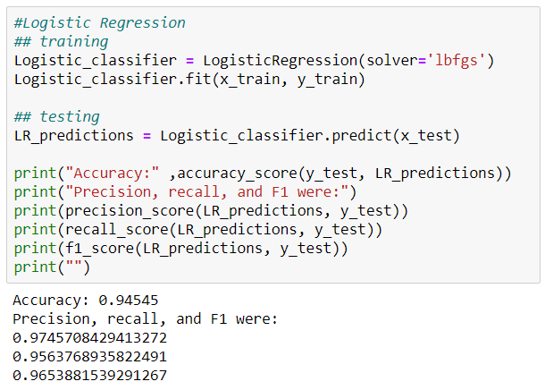
Logistic Regression: A statistical model & a predictive analysis that, in its basic form uses a logistic function to model a binary dependent variable. 𝑃(a prediction is correct ∣ the prediction was positive)= 𝑇𝑃 / (𝑇𝑃+𝐹𝑃) Accuracy: 0.94545 Precision: 0.9745 Recall : 0.9563 F1: 0.9653
Models:

Slide 19
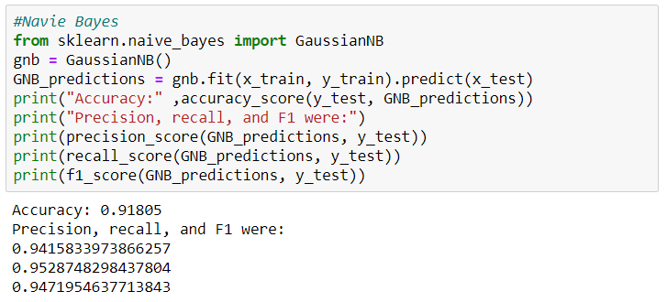
Gaussian Naïve Bayes: Despite its simplicity, Naive Bayesian classifier is widely used because it often outperforms with more sophisticated classification methods. Accuracy: 0.91805 Precision: 0.9415 Recall : 0.9528 F1: 0.9471
Models:

Slide 20
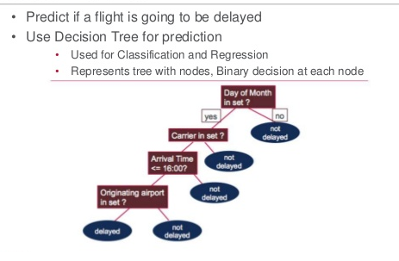
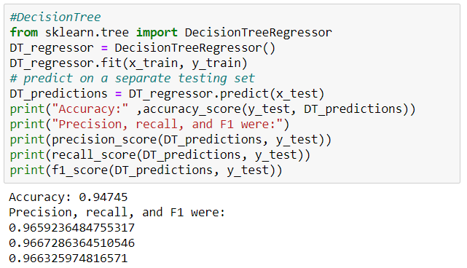
Decision Tree: 𝑃(a prediction is correct ∣ a label is positive) = 𝑇𝑃 / (𝑇𝑃+𝐹𝑁)
Models:
Accuracy: 0.9474 Precision: 0.9659 Recall : 0.9667 F1: 0.9663

Slide 21
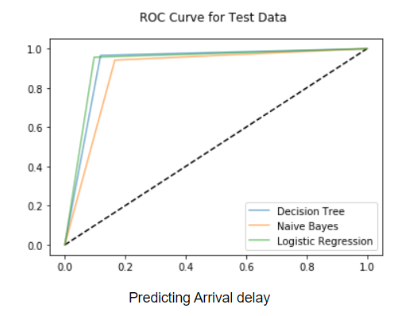
R.O.C Curve for Test data: Test data determines predicting the flight Arrival delays, which can be understood through 3 models - All the 3 applied models resulted nearing values of Model Accuracy, Precision & Recall - Decision tree Model is evidentially the best-fit
conclusion:
Model | Accuracy (%) | Precision | Recall | F
Decision Tree | 94.74 | 0.965 | 0.966 | 0.9663
Naïve Bayes | 91.80 | 0.941 | 0.952 | 0.9471
Logistic Regression | 94.54 | 0.974 | 0.9563 | 0.9653

Slide 22
References: - Dataset obtained from Kaggle: https://www.kaggle.com/fabiendaniel/predicting-flight-delays-tutorial - FAA information: https://www.faa.gov/airports/ - Bureau of Transportation Statistics: https://www.transtats.bts.gov/DL_SelectFields.asp?Table_ID=236&DB_Short_Name=On-Time - US Department of Transportation: https://www.transportation.gov/aviation - IATA (International Air Transport Association): https://www.iata.org/ Modified variables in Dataset: - Created a column describing Flight status - Delay Hours converted into minutes for ease - Converted categorical variables into Numerical data – (Object to Int)
Citation & DATA PREPROCESSING:

Slide 23
- Since the data is extremely huge, applying more Visualization techniques is consuming enormous time - To try with enhanced Permutations & Combinations was a real challenge - The scope for using plotting techniques, data was in support of it - Inadequate data for categorical values (underpinning causes) Future scope: - Analyze & categorize flight delays by reason in specific - Understand the possible delays by human intervention & suggest scope of improvement - Make Observations on Airport Operational practices & apply AI for mundane tasks - Identify reason behind variations of the delays with respect to the origin & destination airports
challenges:

Slide 24
Q&A

Slide 25
Thank you…

